Slide 1
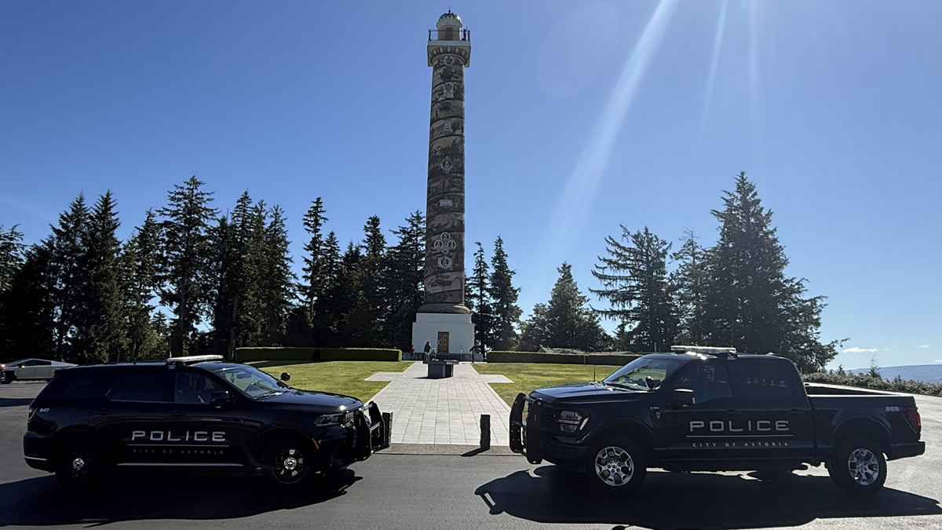
Astoria Police Department

Slide 2
Department Overview
Chief of Police
Patrol
Investigations
Emergency
Communications
Administrative Services:
Records & Evidence

Slide 3
Patrol & Investigation
Stacy Kelly
Chief of Police
Eric Halverson
Deputy Chief
Patrol
Investigation
Andrew Randall
Sergeant (Supervisor)
Thomas Litwin
Sergeant (Supervisor)
Arthur Duryea
Sergeant (Supervisor)
Future:
School Resource Officer
Sergio Carrera Detective
Jair Macareno
Sergeant (Supervisor)
Cory Gerig
Sr. Police Officer
Stephen Sladek
Police Officer
Brian Weber
Police Officer
Eva Khamphouy
Police Officer
Zachary Stockton
Police Officer
Nicholas Bradley
Police Officer
Hunter Michaelson
Police Officer
Luis Marone
Training Academy
Bella Byers Training Academy
Future: Community Resource Officer
Madyson Hanna
Detective
Notes:
Local Agency Patrol Officer Count: APD = 17 + 1 CRO, WPD = 12, CCSO = 26, SPD = 19 + 1 Civilian CSO.

Slide 4
Emergency Communications
Stacy Kelly
Chief of Police
Eric Halverson
Deputy Chief
Candace Pozdolski
Emergency Communications Manager
Jodie Frost
Telecommunications Operator
Annalyssa Wrenn Telecommunications Operator
Micah Spurgeon
Telecommunications Operator
VACANT
Mollie Matthews
Telecommunications Operator
Kiara Stephens
Telecommunications Operator
Megan Holthusen Telecommunications Operator
Brian Rowe
Telecommunications Operator
Edrey Sedano
Telecommunications Operator
Brianna Smith-Montgomery Telecommunications Operator

Slide 5
Administrative Services
Stacy Kelly
Chief of Police
Claude Wrenn
Administrative
Services Manager
Records
Property & Evidence
Ben Rudd Records & Evidence Custodian
Heather Johnson
Sr. Records & Evidence Custodian
Moises Mendez-Hernandez – Cadet

